Slide 1

Exploratory Data Analysis
G2M Case Study
19 June 2022

Slide 2
Agenda
Problem Statement
Objective
Approach
Properties
Assumptions
EDA
EDA Summary and Recommendations

Slide 3

Problem Statement:
XYZ is a private firm in US. Due to remarkable growth in the Cab Industry in last few years and multiple key players in the market, it is planning for an investment in Cab industry and as per their Go-to-Market(G2M) strategy they want to understand the market before taking final decision.

Slide 4
Objective
Help XYZ make the decision on the right company to invest in that is analyze the cab market.

Slide 5
Approach
HOW WILL THE ANALYSIS BE PERFORMED:
Data Exploration Understanding the data and identify certain patterns in the data.
Investigate Determine which cab is most profitable by creating and explaining the relationship.
Hypothesis Recommending the most profitable company for XYZ to invest in.

Slide 6
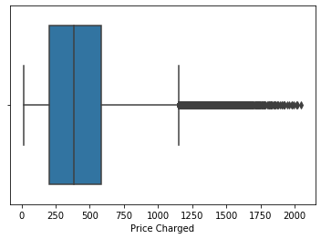
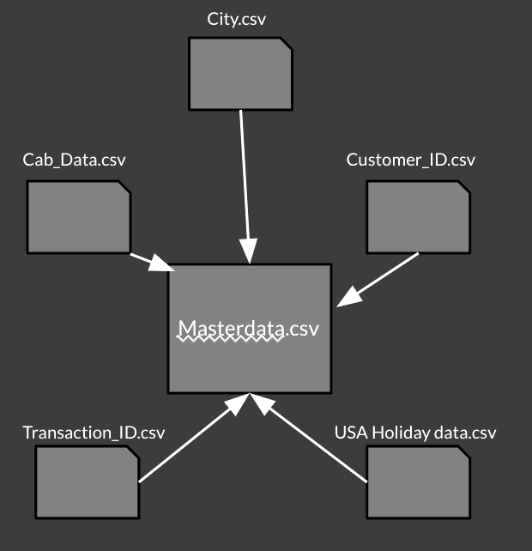
Properties
Time period of the data is from 31/01/2016 to 31/12/2018.
Outliers are present in Price Charged in Cab_Data.csv.
Total of 24 features

Slide 7
Assumptions
The difference of Price Charged and Cost of Trip to be the Profit.
The Date from USA Holiday data.csv to be Holiday in masterdata.csv.
Neglect the outliers in Price Charged since we are calculating the profit.

Slide 8
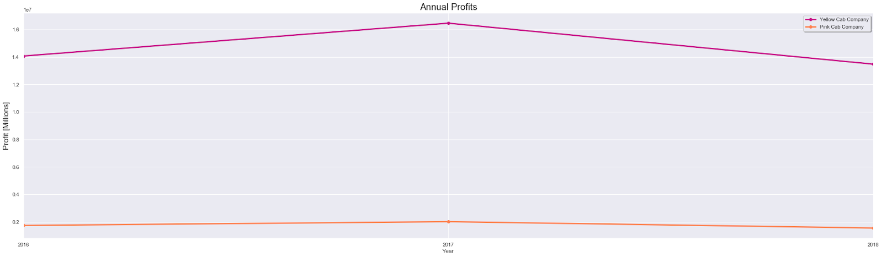
Yearly Profit Analysis

Slide 9
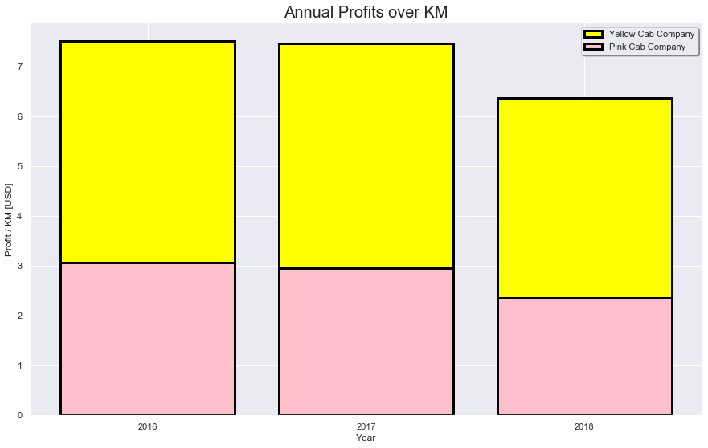
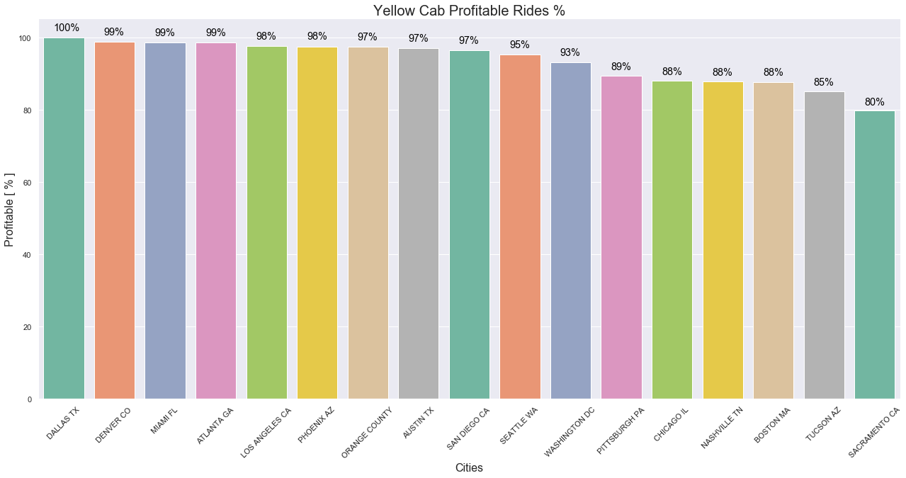
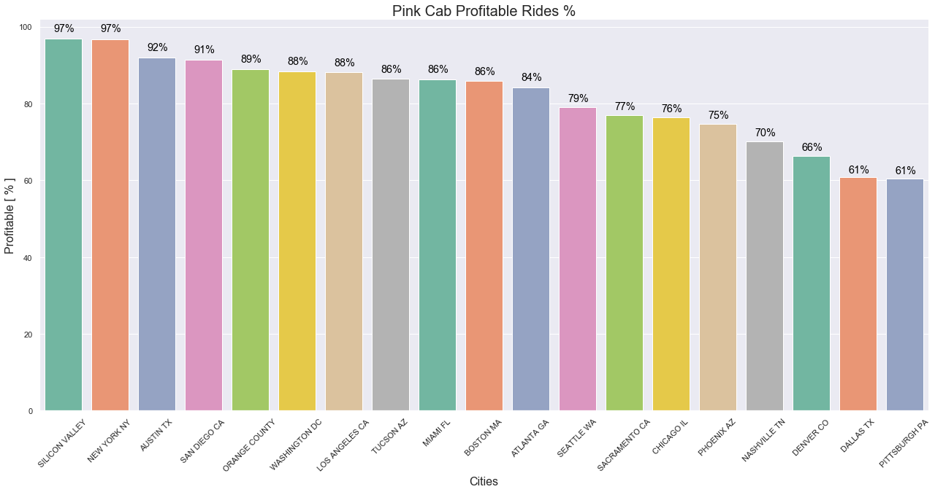
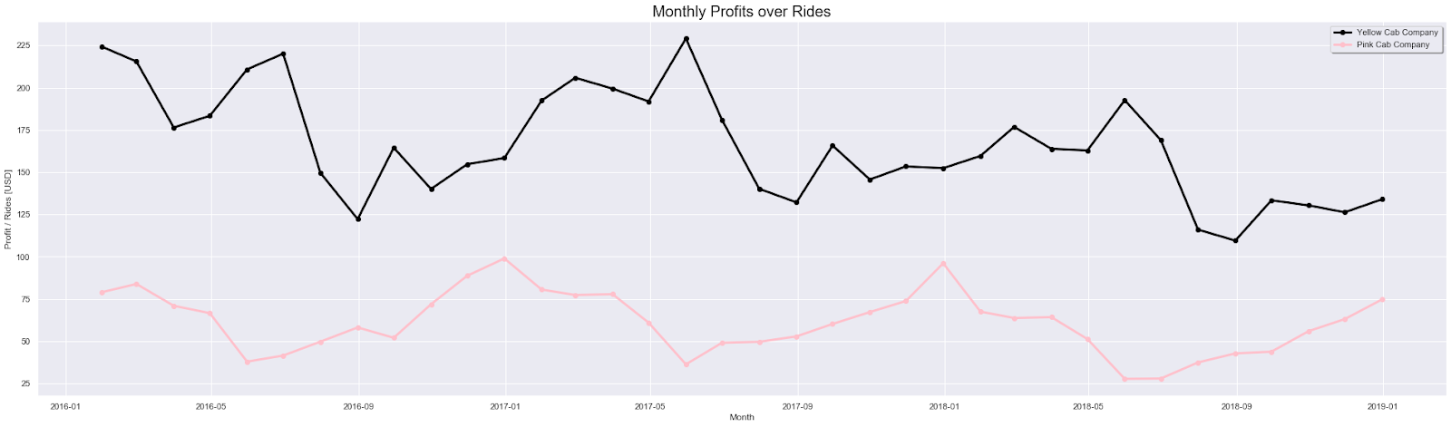
Profit Analysis

Slide 10
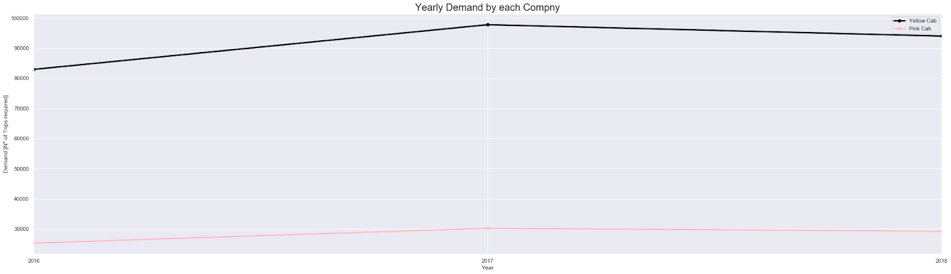
Yearly Demand Analysis
It is observed that the demand for Yellow Cab is almost thrice the demand of Pink Cab throughout the years.

Slide 11
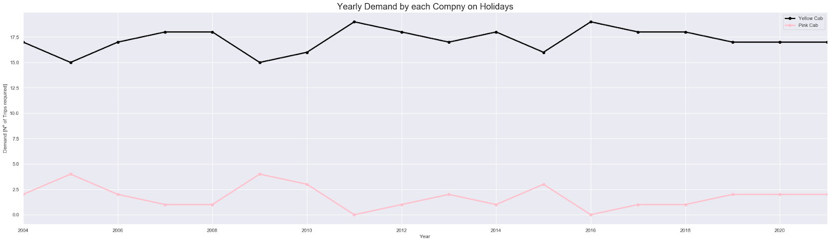
Yearly Demand Analysis on Holidays
The demand for Yellow Cab is almost 8 times the demand of Pink Cab on holidays throughout the years

Slide 12
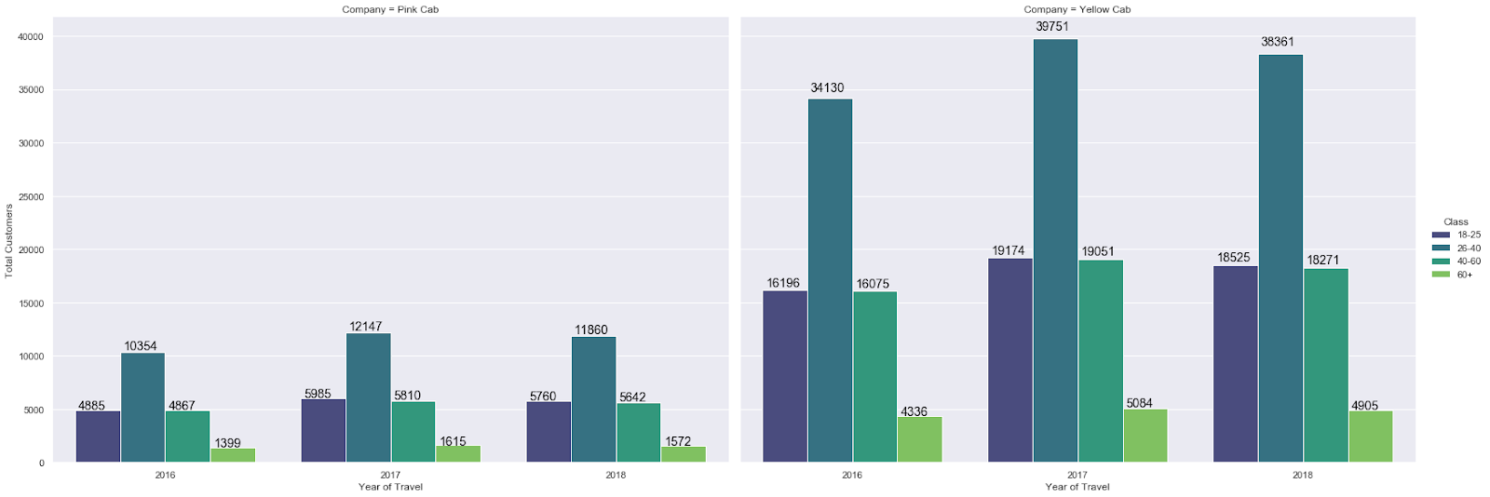
Distribution based on Age Group
The age-wise distribution for both the cab companies is almost the same percentage wise

Slide 13
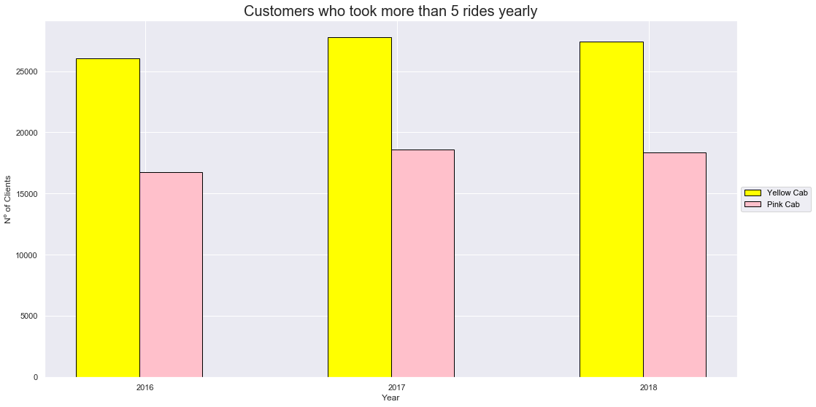
Customer Retention analysis
Customer retention for every 5 rides yearly
It can be noticed that the retention value of the Yellow Cab is around 1.5% of that of Pink Cab

Slide 14
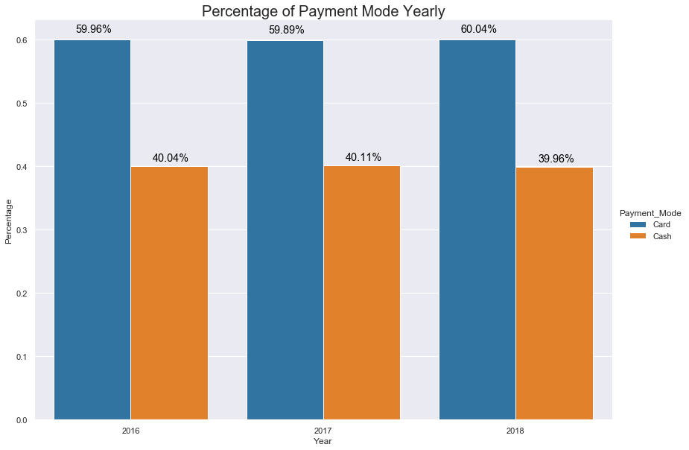
Payment mode analysis
Both companies have similar payment mode distribution

Slide 15
EDA Summary and Recommendation
After evaluation , the Yellow Cab is found to be a more suitable investment for XYZ.
Reasons:
Yearly and Monthly Profit Analysis: Yellow Cab outmatched Pink Cab by a huge margin (about 2-3 times)
Profit Analysis on Holidays: The Yellow Cab is more in demand on holidays
Age-wise distribution: Same distribution
Customer Loyalty: Customers are more loyal to Yellow Cab
Payment-wise distribution: Same distribution

Slide 16

Thank You

